Slide 1
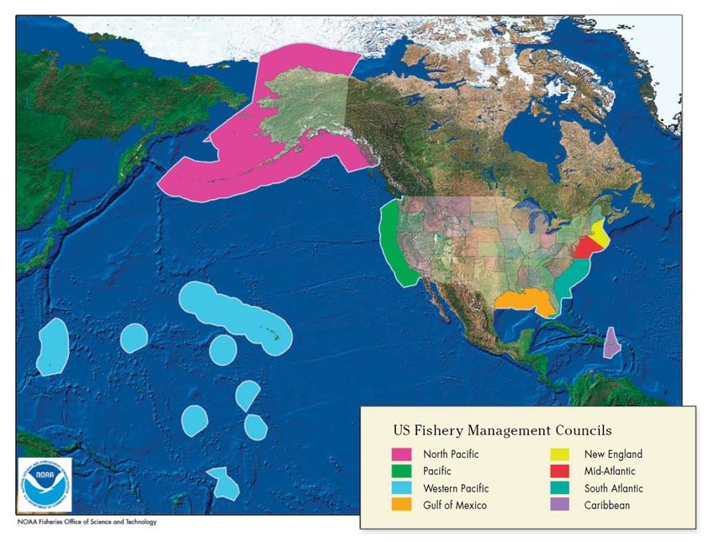
Regional Fishery Management Councils
Magnuson-Stevens (MSA) - main law governing fishing in U.S. federal waters
Enduring legacy of MSA was the establishment of 8 regional FMCs
Quasi-governmental bodies made up of officials from U.S. states, territories, and Native American tribes, plus private citizens with fisheries-related expertise

Slide 2
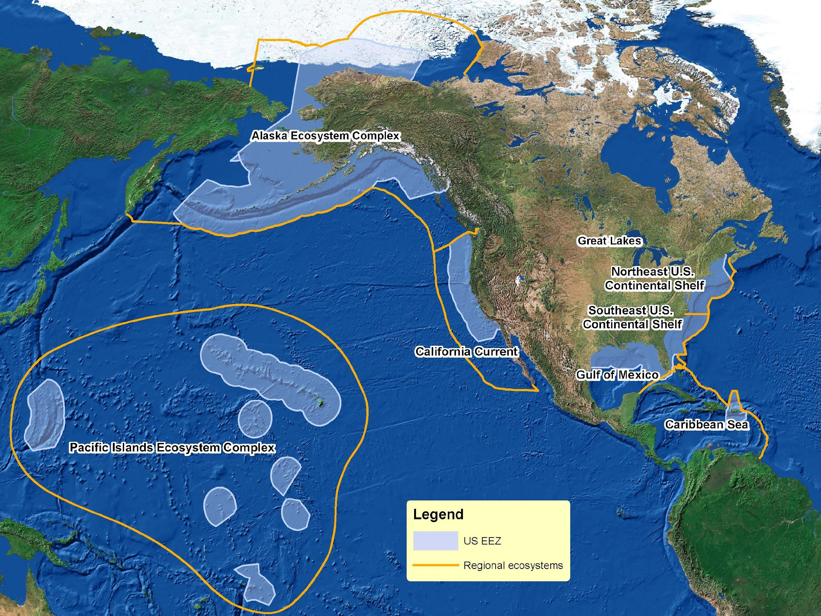
Regional Fishery Management Councils
Magnuson-Stevens (MSA) - main law governing fishing in U.S. federal waters
Enduring legacy of MSA was the establishment of 8 regional FMCs
Quasi-governmental bodies made up of officials from U.S. states, territories, and Native American tribes, plus private citizens with fisheries-related expertise
FMCs jurisdictions loosely organized by large marine ecosystem
Notes:
The most enduring legacy of the 1976 act was the establishment of regional fishery management councils. These councils are quasi-governmental bodies made up of officials from U.S. states, territories, and Native American tribes, plus private citizens with fisheries-related expertise, all with interests in marine fish stocks in their regions. Most fishery management councils [CLICK] have jurisdictions loosely organized by large marine ecosystem – a structure that has proved helpful to modern fishery managers developing ecosystem-based fisheries management policies and programs.
Most fishery management councils [CLICK] have jurisdictions loosely organized by large marine ecosystem – a structure that has proved helpful to modern fishery managers developing ecosystem-based fisheries management policies and programs.
The Pacific Fishery Management Council has jurisdiction over the marine fisheries off the U.S. West Coast, from the 3 nautical mile outer marine boundary of the states of Washington, Oregon, and California to the 200 nautical mile outer boundary of the Exclusive Economic Zone.
In the U.S., our guiding law for marine fisheries was first passed in 1976, and is now known for two influential legislators as the Magnuson-Stevens Fishery Conservation and Management Act, or just Magnuson-Stevens Act. For the first 20 years of the Act, U.S. fisheries management was largely concerned with Americanizing the fisheries. In other words, building up U.S. fishing and processing capacity so that we could declare our Exclusive Economic Zone species fully utilized and end the practice of allowing foreign fishing within that zone.
The Magnuson-Stevens Fishery Conservation and Management Act (MSA) is the main law that governs fishing in U.S. federal waters, ranging from 3 to 200 miles offshore. First passed in 1976, the MSA established a 200-mile Exclusive Economic Zone (EEZ) and created eight regional fishery management councils to manage our nation’s marine fishery resources. This unprecedented management system gives fishery managers the flexibility to use local level input to develop management strategies appropriate for each region’s unique fisheries, challenges, and opportunities

Slide 3
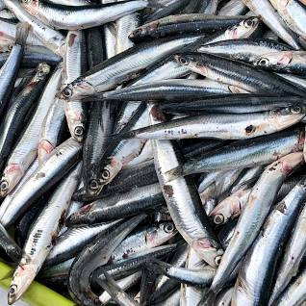
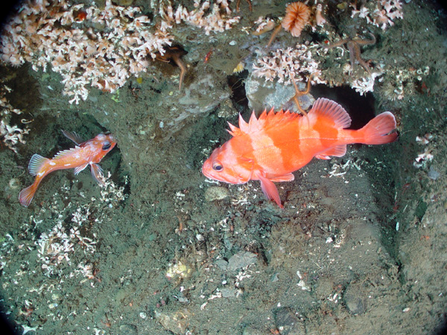
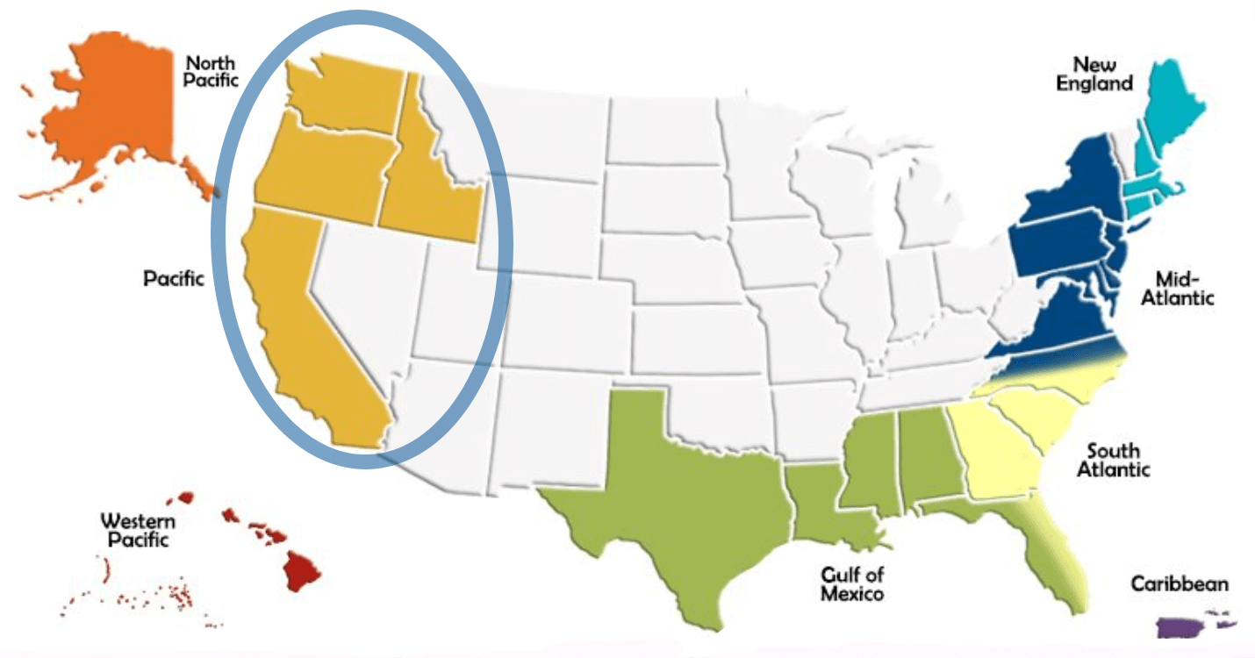
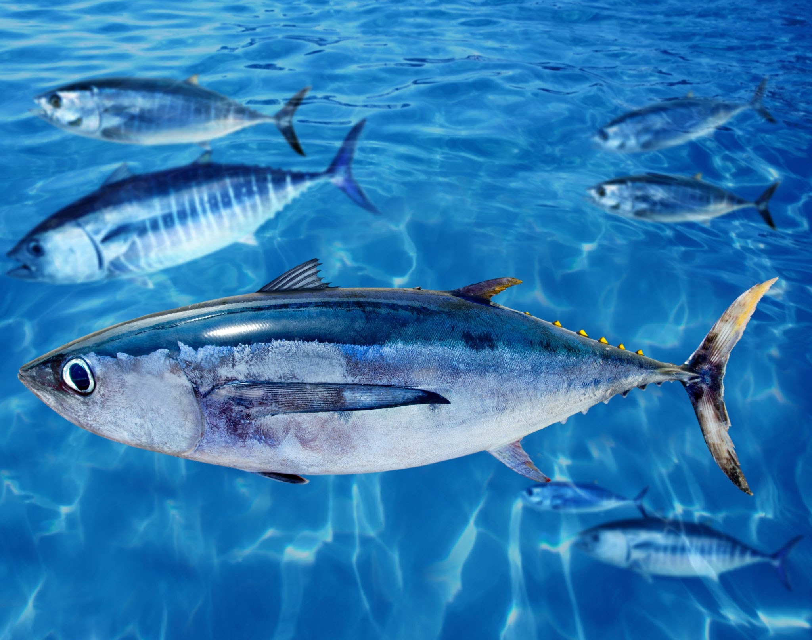
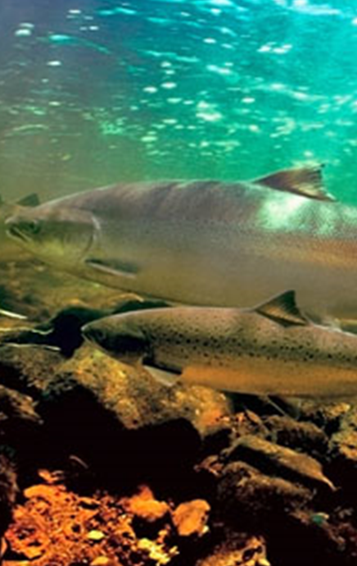
Pacific Fishery Management Council (PFMC)
100+ species:
Coastal pelagics
Groundfish
Highly migratory species
Salmon
Notes:
The Pacific Fishery Management Council has jurisdiction over the marine fisheries off the U.S. West Coast, from the 3 nautical mile outer marine boundary of the states of Washington, Oregon, and California to the 200 nautical mile outer boundary of the Exclusive Economic Zone. Off the northern coast, four tribes with treaty rights to marine species (Makah, Quileute, Hoh, and Quinault) have Usual and Accustomed fishing areas that can extend as far out as about 40 nautical miles offshore, and numerous additional inland tribes and the State of Idaho have authorities over nearshore and inland fisheries for salmonids and other anadromous species.
Our Council manages over 100 species of fish and invertebrates, organized into these four fishery management plans: the small coastal pelagic species like market squid, anchovy, and sardine; groundfish or bottom fish, such as rockfishes, roundfish, flatfish, and some odd benthic sharks and chimera; highly migratory species are all of those very large pelagics like tunas, swordfish, sharks; and, of course, Pacific salmon species.

Slide 4
Pacific Fisheries Management Council (PFMC)
Fishery Management Plans (FMPs)
Ecosystem workgroup
Highly Migratory Species
Salmon
Fishery Ecosystem Plan (FEP)
Groundfish
Coastal Pelagic Species
FEP Ecosystem Initiatives
*each FMP has a Management Team and an Advisory Subpanel
Notes:
And the species are organized into these four fishery management plans for marine fisheries in waters seaward of state waters: highly migratory species are all of those very large pelagics like tunas, swordfish, sharks; Pacific salmon species; groundfish such as rockfishes, flatfish, and some odd benthic sharks and chimera; and the small coastal pelagic species like anchovy and sardine. And there is also a fishery ecosystem plan that I’ll talk about in a minute.
FEP: Better understand how the environmental, human activities, and social-ecological dynamics affect the species and fisheries we manage and the future
The FMPs and specific management measures (such as fishing seasons, quotas, and closed areas) are developed based on sound scientific advice, and are initiated, evaluated, and ultimately are adopted in a fully transparent and public process.
Under the Fishery Ecosystem Plan, the Council has created ecosystem initiatives, cross multiple fisheries and to coordinate policies that would not necessarily fit well into just one of our fishery management plans. Our first ecosystem initiative reviewed the role of unfished forage fish in the diets of marine predators, and allowed us to ultimately prohibit the take of a variety of lower trophic level species off our coast. Our second ecosystem initiative was a hard look at the annual ecosystem status report that tuned the contents of the report to the council’s fishery management needs and set up an annual ecosystem science review process within the Council.
EWG provides technical and policy advice in support of the PFMC Fishery Ecosystem Plan (FEP) which is to:
Enhance the Council’s management programs with more ecosystem science, broader ecosystem considerations, and management policies that take into account the role of the ecosystem.
Identify and prioritize research needs and provide recommendations to address gaps in ecosystem knowledge and FMP policies
to enhance the Council’s species-specific management programs with more ecosystem science, broader ecosystem considerations, and management policies that coordinate Council management across its FMPs and the CCE.
an FEP should identify and prioritize research needs and provide recommendations to address gaps in ecosystem knowledge and FMP policies, particularly with respect to the cumulative effects of fisheries management on marine ecosystems and fishing communities.
The FEP is meant to be an informational document, and is not meant to be prescriptive relative to Council fisheries management.
Information in the FEP, results of the Integrated Ecosystem Assessment (IEA), and the Annual State of the California Ecosystem Report are available for consideration during the routine management processes for fisheries managed in each FMP. How exactly these items will affect fishery management decisions is at the discretion of the Council.

Slide 5
For each FMP and management of their stocks
Science Center Stock Assessor
Independent review panel (STAR)
Science and Statistical Committee
Management Team
Advisory Subpanel
Public Comment
Council Members
NMFS
Secretary of Commerce
Notes:
For each FMP the management cycle of the stocks starts with the development of the stock assessment by science center scientists…
These plans and measures are implemented by the National Marine Fisheries Service.
The Council has 14 voting representatives from Oregon, Washington, California, and Idaho; many advisory bodies; and 16 staff members located in Portland, Oregon. Some Council members represent state or tribal fish and wildlife agencies, and some are private citizens who are knowledgeable about recreational or commercial fishing or marine conservation. Apart from state and tribal representatives, Council members are chosen by the governors of the four states within the Council region, in conjunction with the Secretary of Commerce.

Slide 6
For each FMP and management of their stocks
Where does ecosystem and climate information fit into this process?
Within the
assessment
Science Center Stock Assessor
Science and Statistical Committee
Alongside the
assessment
Management Team
Advisory Subpanel
Public Comment
Council Members
NMFS
Secretary of Commerce
Notes:
Be explicit- about onramps other ways to bring into harvest specifications
Some of the ways are risk tables and ESR
For example,
These plans and measures are implemented by the National Marine Fisheries Service.
The Council has 14 voting representatives from Oregon, Washington, California, and Idaho; many advisory bodies; and 16 staff members located in Portland, Oregon. Some Council members represent state or tribal fish and wildlife agencies, and some are private citizens who are knowledgeable about recreational or commercial fishing or marine conservation. Apart from state and tribal representatives, Council members are chosen by the governors of the four states within the Council region, in conjunction with the Secretary of Commerce.

Slide 7
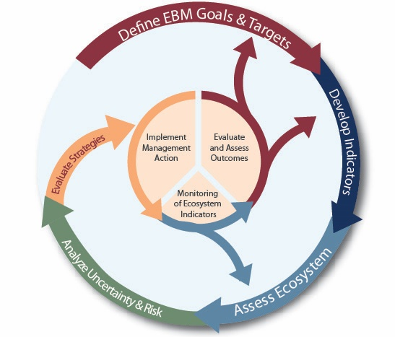
The NOAA Integrated Ecosystem Assessment (IEA)
First outlined by Levin et al. (2009), building on many other decision-support frameworks
Core elements:
Define goals and targets
Develop indicators and assess ecosystem
Risk assessment
Evaluate alternative management scenarios
(repeat as actions are implemented or changes occur)
Notes:
On the west coast, the ecosystem information that is produced to support fisheries management is based on NOAA’s Integrated Ecosystem Framework. The IEA is essentially a framework that was first published in 2009 by Phil Levin and colleagues, who based it on many other decision-support frameworks. And it is intended to help synthesize and integrate different types of information on the ecological and human parts of an ecosystem to provide management advice.
The core elements are of the framework are shown here, and for this presentation, I’m really going to focus on the second element in the framework – which is the development of indicators and ecosystem assessment. I’m also focusing on the California Current ecosystem but the information is relevant to other regions as well.

Slide 8
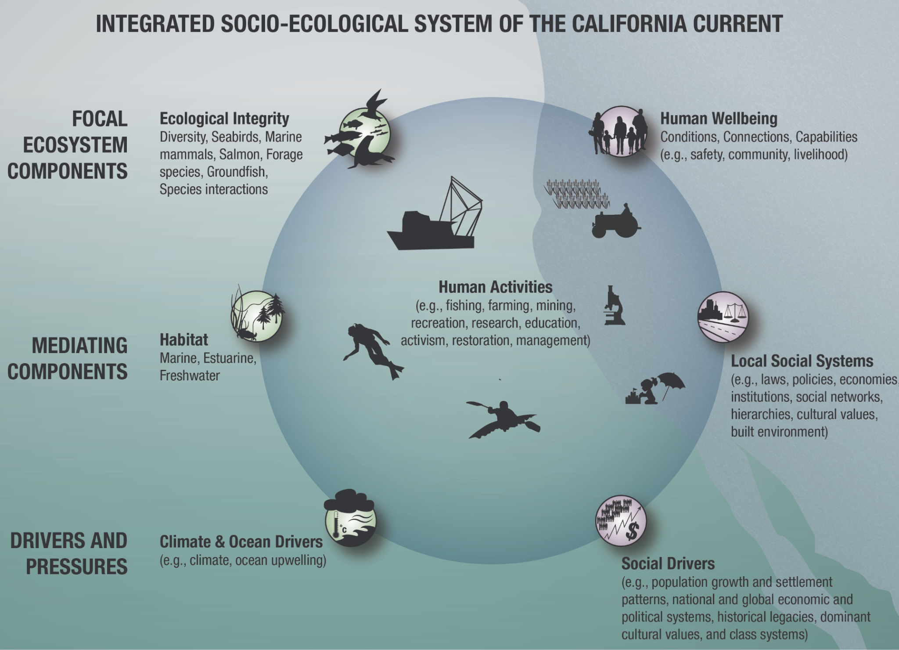
California Current IEA
Key Information Needs:
Time series
Broad Spatial Data
Regularly collected
Readily accessible
Key Indicator Needs:
“Easy” to understand
Clear connection to management issue
Notes:
The figure on this slide illustrates the different components of the integrated socio-ecological system of the California Current, which include the ecological components, human activities and human well-being, as well as climate and ocean drivers and social drivers. The California Current IEA team (which is comprised of scientists from the SW and NW fisheries science centers) has developed many indicators of these various components but this is also on ongoing process as we try to address the needs of managers, stakeholders, and human communities as best as possible.
The types of data we use or need include time series data, data that cover a large spatial domain, and data that are regularly collected and easily accessible. And an important requirement for indicators is that they are easy to understand and have a clear connection to a management issue.

Slide 9
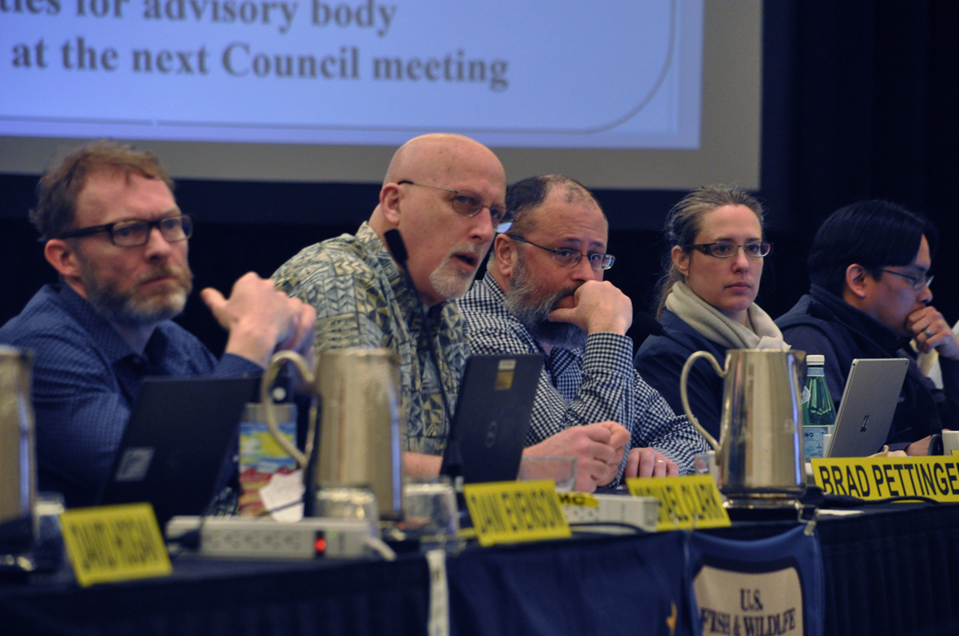
How is the information delivered?
Annual presentation of
Ecosystem Status Report to the PFMC
Summarizes to assess status of the CCE, used to interpret and communicate changes
Notes:
The co-leads of the ESR provide an annual ecosystem status report to the Pacific Fishery Management Council every March. Present to various AB bodies. This year Andy Leising (SWFSC) and I presented the report. This report provides general ecosystem overviews, based on status and trends in indicators that run from climate and physics to the status of important species to human activities, fishery landings and revenues. This information can be valuable in helping the Council consider precautionary options or make strategic decisions. It’s a very large effort and involves many collaborators, including NMFS scientists and external partners from academic institutions and state agencies. This year we had 90+ contributors.

Slide 10
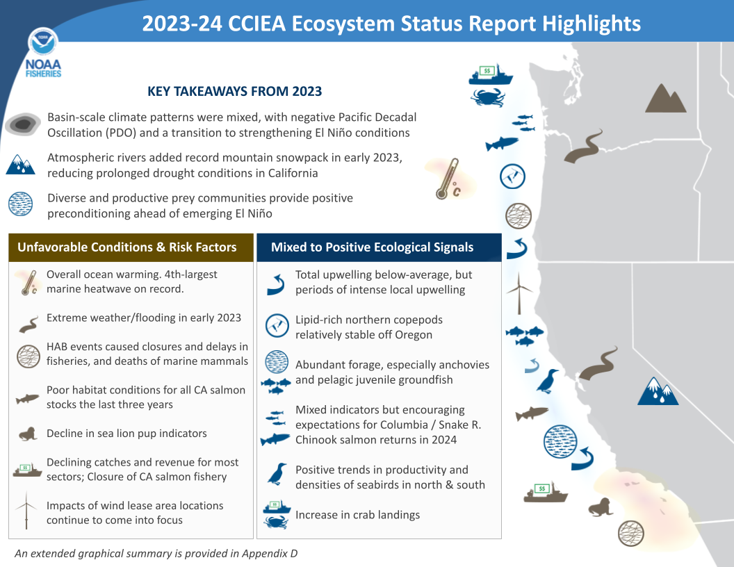
How is the information delivered?
CCIEA website with: Infographics, current conditions, custom plotting tools
Annual presentation of
Ecosystem Status Report to the PFMC
Summarizes to assess status of the CCE, used to interpret and communicate changes
https://www.integratedecosystemassessment.noaa.gov/
regions/california-current
Notes:
Other ways to present this information

Slide 11
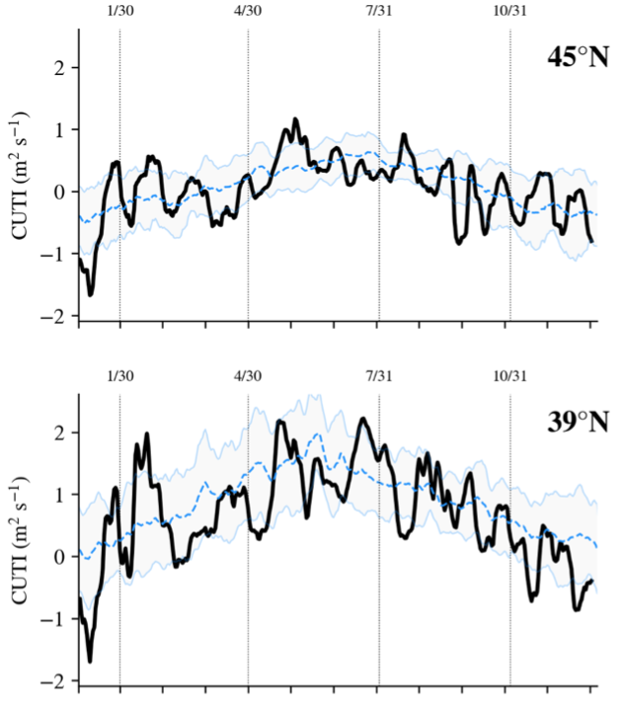
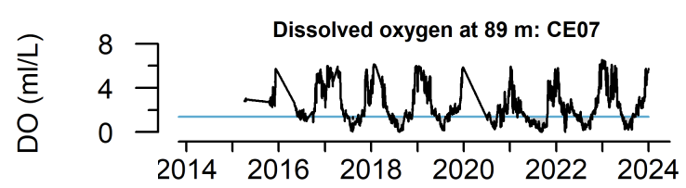
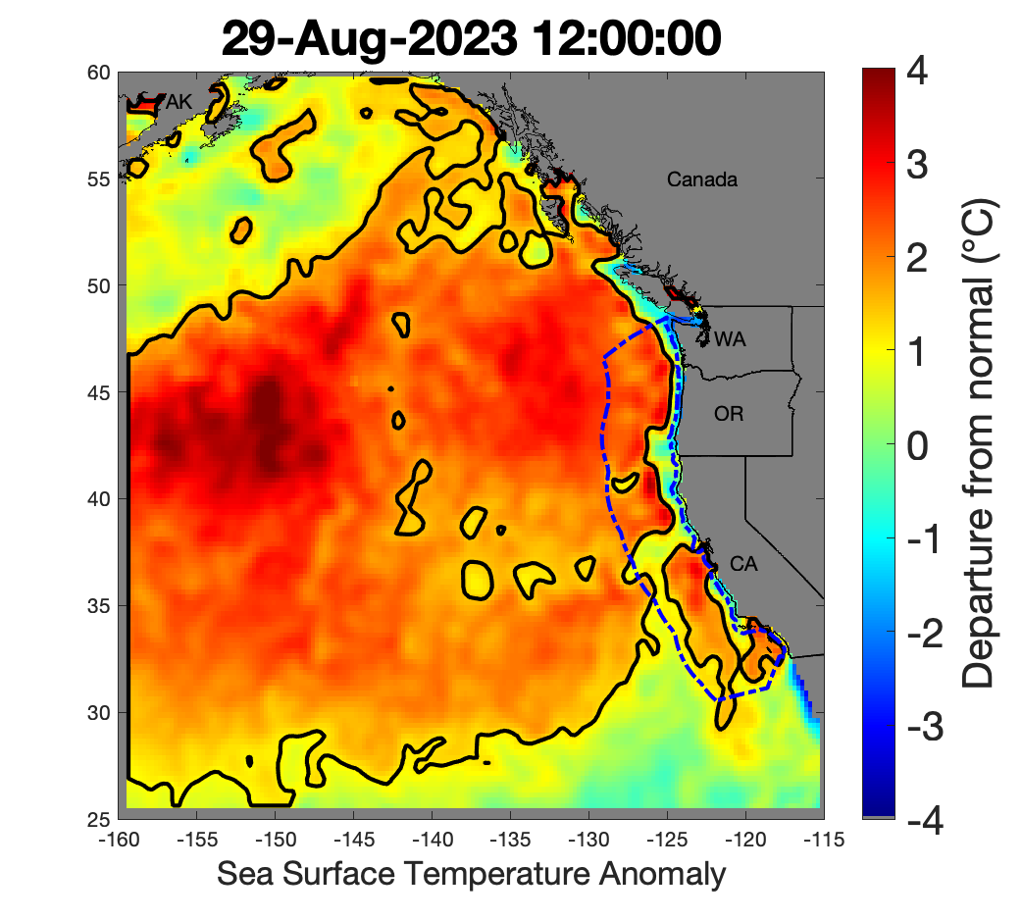
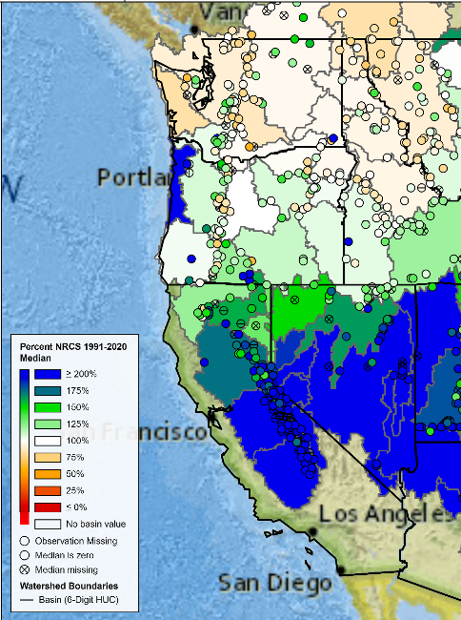
Examples of physical, ecological, human activity indicators in the 2023-24 report
Climate and physics
Leising et al. 2024, Council Report Agenda Item H.1.a
Notes:
Get info on oxygen from OOI

Slide 12
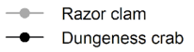
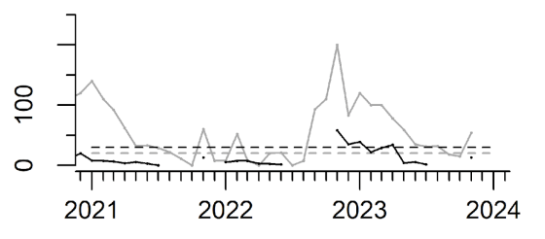
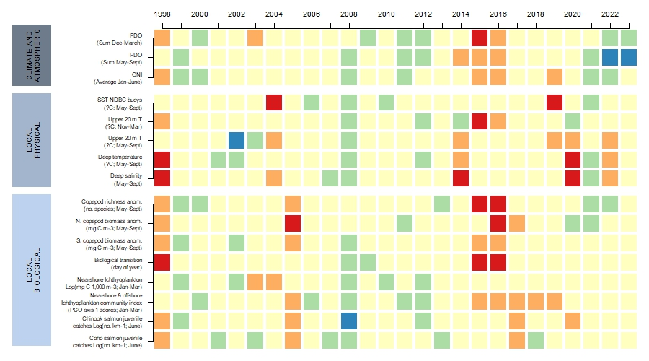
Examples of physical, ecological, human activity indicators in the 2023-24 report
Climate and physics
Status of important species
Oregon coast
Monthly max (ppm)
Salmon stoplight tables
Leising et al. 2024, Council Report Agenda Item H.1.a
Notes:
Get info on oxygen from OO!

Slide 13
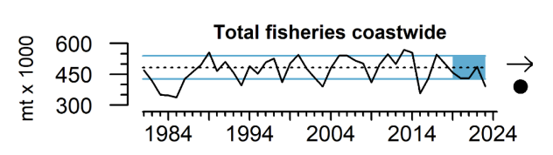
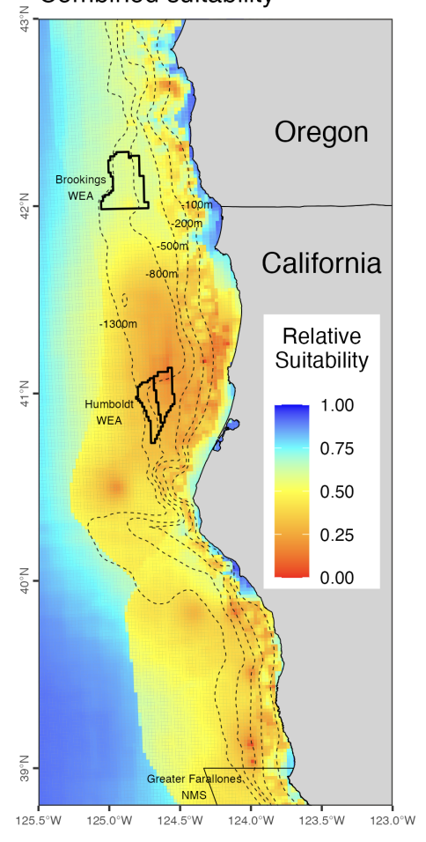
Examples of physical, ecological, human activity indicators in the 2023-24 report
Climate and physics
Status of important species
Fisheries,
human activities
Oregon coast
Monthly max (ppm)
Salmon stoplight tables
Leising et al. 2024, Council Report Agenda Item H.1.a
Notes:
Get info on oxygen from OO!
Domoic acid concentration in razor clams (gray solid lines) and Dungeness crab viscera (black solid lines) through 2022 for WA, OR, northern CA (Del Norte to Mendocino counties), and central CA (Sonoma to San Luis Obispo counties). Dashed lines are the management thresholds of 20 ppm (clams, gray) and 30 ppm (crabs, black).
Help inform siting of offshore wind energy development

Slide 14
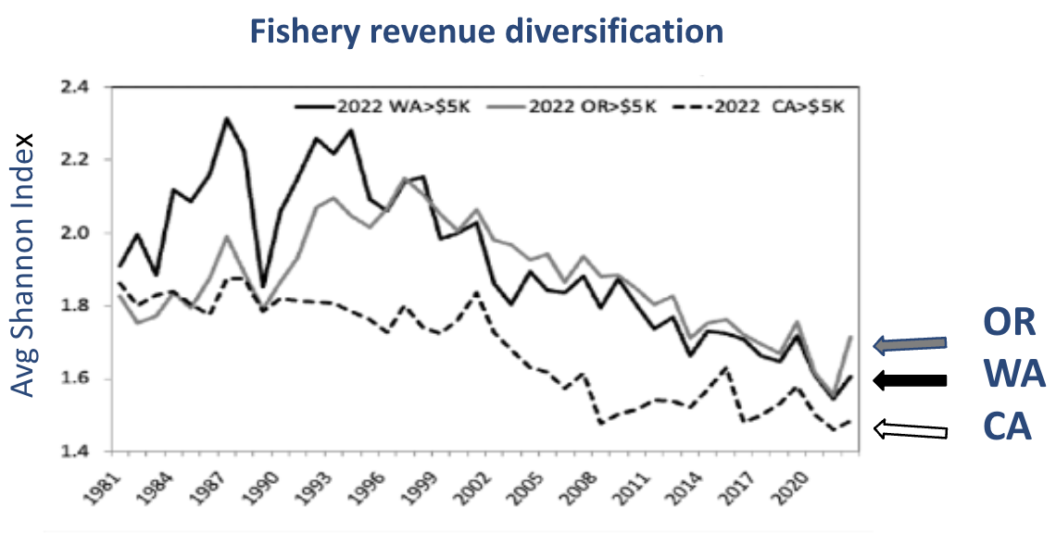
Human wellbeing
Greater diversification of fishing portfolios may increase average revenue and reduce yearly revenue variability; possibly greater resilience to shocks
Diversification <- measure of how revenue is spread across species groups
Notes:
One measure of human well-being that we have been presenting in the ESR over the past few years is fishery diversification. The idea here is that diversifying fishing across multiple fisheries or regions could increase revenue and reduce variability in revenue and possibly buffer vessel owners from fishery shocks. The CCIEA team has been measuring multiple types of fishery diversification, including revenue diversification, which measures how revenue is spread across species groups. This figures shows that, in general, revenue diversification has been declining for west coast fishing vessels since the mid-1990s which can pose more risk to vessel owners, although we note that California, Oregon and Washington fleets saw small increases in diversification in 2022 relative to 2021.
As I just mentioned, west coast vessel owners can reduce income variability and financial risk by diversifying their fishing portolio but they may be even more effective at reducing their financial risk by diversifying income from non-fishing occupations (which is also referred to as livelihood diversification).

Slide 15

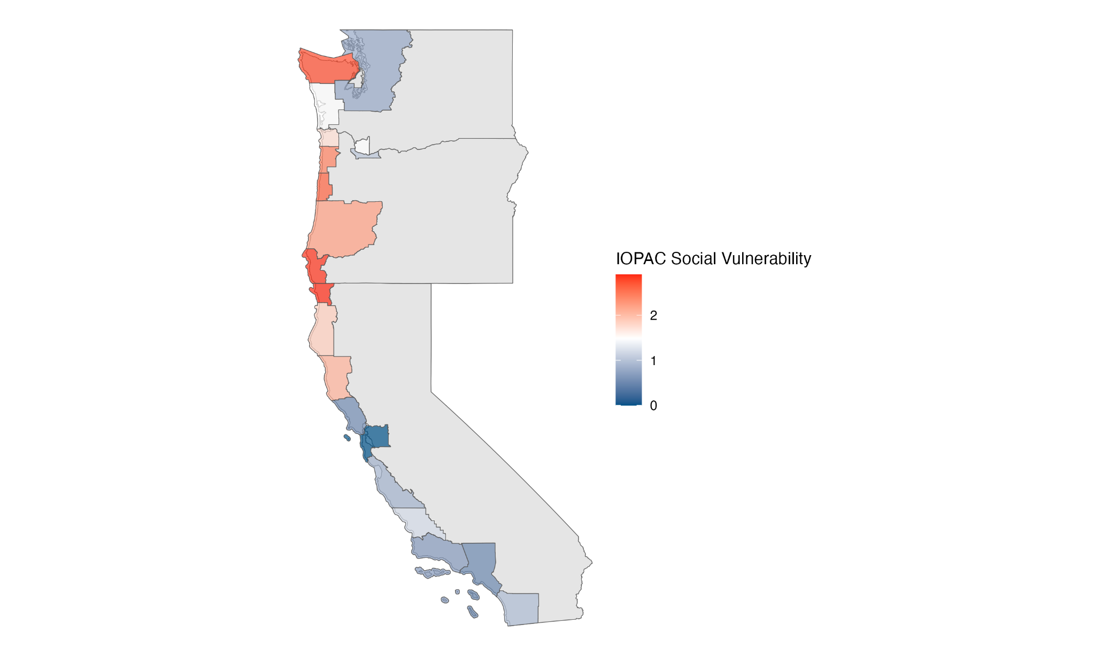

Human wellbeing
Westport
Ilwaco
Cathlamet
Tokeland
Chinook
Greater diversification of fishing portfolios may increase average revenue and reduce yearly revenue variability; possibly greater resilience to shocks
Nehalem
Garibaldi
Hebo
Winchester Bay
Port Orford
Trinidad
Jenner
Bodega Bay
Bethel Island
Social Vulnerability
Social Vulnerability
Moss Landing
Less
More
Diversification <- measure of how revenue is spread across species groups
0 1 2
Commercial
Recreational
Both
Notes:
The CCIEA team has also updated the social vulnerability scores for commercial and recreational fisheries for communities in five regions, including Washington, Oregon, and northern, central and southern California. The figures are based on the most recent available data and include the five highest-scoring communities for commercial and recreational fishing reliance for each region, which are grouped by the different colored polygons in the figures. Communities in the upper right quadrant of both plots are those with relatively high social vulnerability and either high commercial fishing reliance or high recreational fishing reliance. And I want to mention that this is the first year we’ve been able to include metrics of recreational reliance. Overall, the figures indicate that there is higher vulnerability of commercial and recreational fishing communities in Washington and Oregon than in California. This geographic pattern is echoed in some work led presented in this year’s Climate Change Appendix which predicts that groundfish fishing fleets in the northern region of the CC are more vulnerable and at higher risk to climate change than groundfisgh fishing fleets in the south.

Slide 16
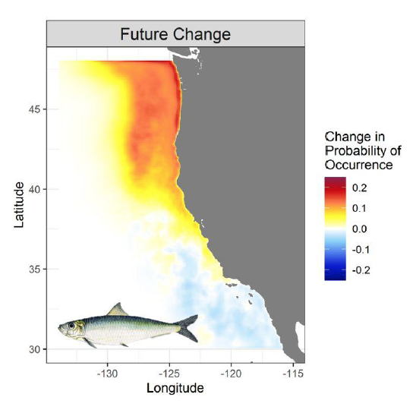
Supporting climate-ready fisheries
The “Climate Change Appendix” includes new research to support climate-informed decision-making:
Seasonal forecasts of marine heatwaves
Projections of long-term shifts in the distribution and abundance
Social-ecological vulnerability and climate risk for fishing fleets
Carol Leigh
H.1.a Supplemental CCIEA Team Report 2: Appendix E.
Developing Indicators of climate change and variability
Notes:
And lastly, the CCE has been reasonably resilient to climate and ocean conditions in 2023 and in prior years however it’s unlikely that the system can sustain this resilience indefinitely, especially in the face of climate change. The CCIEA team is well positioned to support efforts aimed at better understanding the impacts of climate change on west coast species and quantifying risk posed to West Coast fisheries and fishing communities. This year’s climate change appendix highlights some of these efforts coming out of the Future Seas project and the Groundfish, Climate Change, and Communities in the California Current project (also known the GC5 project).
Climate change appendix: to specifically include considerations of current and future climate change impacts on the California Current and managed species. For example, we’d like to include climate projections of the physics and biology, e.g., HABs, shift in species distributions, changes in habitat indices.
Mention FUTURE Seas and GC5 projecy

Slide 17
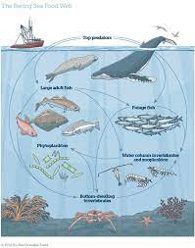
Fishery Ecosystem Plan - Ecosystem Initiative
Ecosystem and Climate Information for Species, Fisheries, and FMPs
Determine the need and appropriate timing for additional, FMP-specific ecosystem and climate information, and
Develop clear pathways for this information to be used in the setting of scientific uncertainty, harvest policy, and specific management actions.
Notes:
I’m going to start our presentation by briefly reviewing the purpose or goals of the Initiative 4, which is also referred to as the Climate and Ecosystem Initiative
Today, our presentation and discussions are mainly focused on two other tasks for the initiative which were to draft a risk evaluation rubric that could be used across species, stocks and FMPs to highlight potential issues that should be considered in decision-making, but which are not directly accounted for in the assessment model. And then to apply the rubric to two pilot species, petrale sole and sablefish. The risk evaluation rubric is presented in our main report to the Council and I will be talking a bit more about it today. The pilot risk evaluation tables are presented in our supplemental report and Kiva Oken will walk us through those later today.

Slide 18
Risk tables
Document, compare and rate information from the various sources
 | Ecosystem-related | Population dynamics | Assessment-related
Level 1: Above or better than normal | Some indicators show the system supporting greater abundance or increased habitat area | Stock trends are above normal for the stock; recent recruitment is above normal range | Below-average uncertainty/very few unresolved issues in assessment, no or few data conflicts
Level 2: Normal | No apparent environmental/ecosystem concerns | Stock trends are typical for the stock; recent recruitment is within normal range. | Typical to moderately increased uncertainty/minor unresolved issues in or data conflicts assessment
Level 3: Substantially increased concerns | Some indicators show adverse signals but the pattern is not consistent across all indicators. | Stock trends are unusual; abundance increasing or decreasing faster than has been seen recently, or recruitment pattern is atypical. | Substantially increased assessment uncertainty/ unresolved issues, or data conflicts
Level 4: Major Concern | Most indicators showring consistent adversre signals a) across the same trophic level, and/or b) up and down trophic levels (i.e. predators and prey of stock( | Stock trends are highly unusual; very rapid changes in stock abundance, or highly atypical recruitment patterns. | Major problems with the stock assessment, poor fits to data, high level of uncertainty, strong retrospective bias.
Low concern
High concern
Notes:
draft a risk evaluation rubric that could be used across species, stocks and FMPs to highlight potential issues that should be considered in decision-making, but which are not directly accounted for in the assessment model. And then to apply the rubric to two pilot species, petrale sole and sablefish.
The rows of this table describe the factors or conditions that are associated with different risk levels that range from 1 – 4 , where level 1 indicates conditions are above or better than normal for a particular species with respect to the environmental and ecosystem considerations, the assessment considerations, or the pop dynamic considerations and therefore there is low concern about that species. Whereas the highest level, level 4, indicates that there is major concern about a species with respect to three different categories. Within the environmental and ecosystems category, the recommended risk level will depend on whether physical and biological indicators indicate the environmental and ecosystems conditions will have a positive effect, little effect, or adverse effect on species. Within the assessment model category, the recommended risk level will depend on various factors, including the amount of model uncertainty, unresolved issues, data conflicts, and whether there is a strong retrospective bias or not. Within the population dynamics, the recommended risk level will depend on whether the stock trends and recent recruitment are above normal, typical’, or atypical. For example, a stock would be assigned a level 3 or 4 if its abundance was changing faster than has been observed recently.

Slide 19
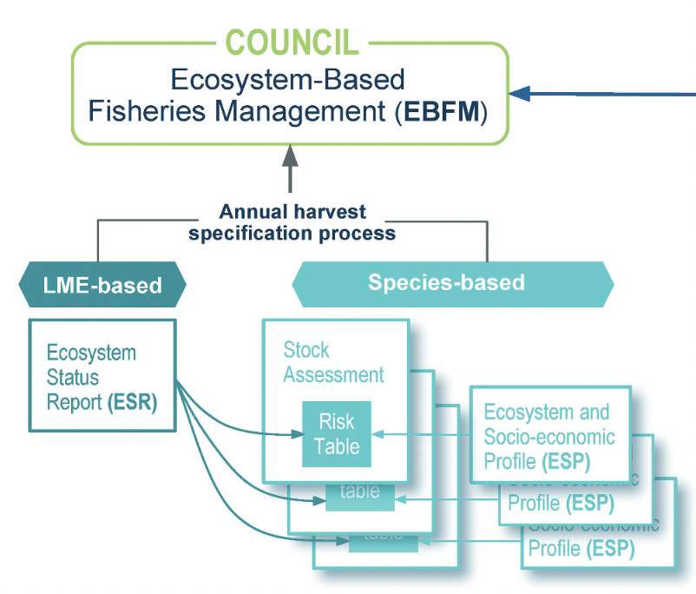
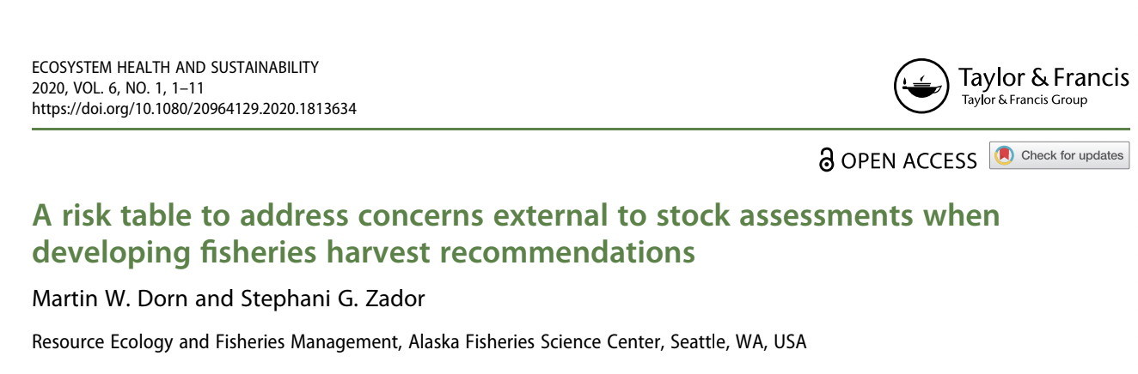
Not meant to be a comprehensive evaluation, provides info that might inform ABC
Formalizes and documents the process for change in harvest policy and if contextual information is used to inform this decision
Provides transparency in a consistent framework
Normalizes discussions between stock assessors and ecosystem scientists
Notes:
The risk table methodology we are developing for use by the PFMC has been adapted from the methods in use by the North Pacific Fishery Management Council. AFSC scientists, Martin Dorn and Stephani Zador, developed this method to bring contextual information into decision-making process for determining future ABC recommendations for Alaskan groundfish fisheries
the risk table is not intended to be a comprehensive evaluation of how env and ecosystem conditions affect a particular species but provides more targeted info that might inform the ABC. This method formalizes …. Contextual info, info that is not already provided in the assesement. It provides transparency in how decisions are made and the information that is considered in making those decisions. And it also fosters discussions stock assessment scientists and ecosystem scientists.
A bit of background on the risk tables - based on our webinar in May
CIE (NOAA Comm. of Independent Experts) review was very positive on AK rish tables
Get info into stock assessment process at early stage (during model development, prior to Council meeting)
Ecosystem info coming into pipeline through two pathways, ESR and stock assessments
During the EWG webinar last May, Stephani Zador gave a presentation on the use of risks tables by the NPFMC. And she made some important points that resonated with many us. For example, the risk table is not intended to be a comprehensive evaluation of how env and ecosystem conditions affect a particular species but provides more targeted info that might inform the ABC. This method formalizes …. Contextual info, info that is not already provided in the assesement. It provides transparency in how decisions are made and the information that is considered in making those decisions. And it also fosters discussions stock assessment scientists and ecosystem scientists.

Slide 20
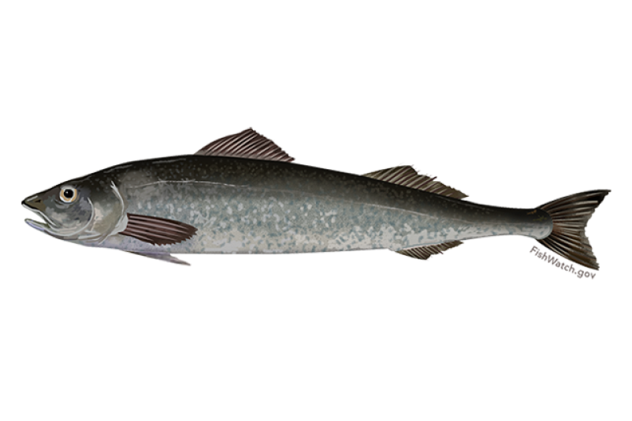
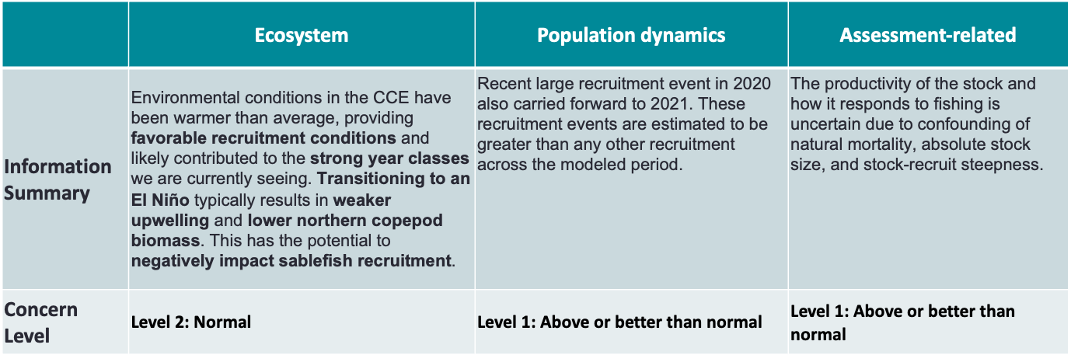
2023 CCE Sablefish risk table:
Notes:
Chosen because both have assessments or assessment updates being conducted in 2023 and are science-ready.
Sablefish added later to EI4 and assessment docket in part due to information from 2023 ESR on strong incoming year class
EWG held meeting in May with engaged participation by stakeholders, GMT members, and stock assessors, ecologists, and other scientists.
In addition to risk tables, groundfish experts emphasized potential for climate information to inform assessment prioritization
an overall risk level assignment requires a weighting scheme to account for the relative magnitude of the effect of these factors on stock characteristics of concern.
Now, if these had indicated higher levels of concern or if there had been considerable disagreement across different sources of information, the Council might have chosen a precautionary recommendation for harvest levels, relative to the recommendation from the stock assessment.
This approach nicely integrates relevant ecosystem information into the management process, and seems likely to be adopted elsewhere; I believe it is now being considered by the IEA team and Councils in the Northeast US.

Slide 21
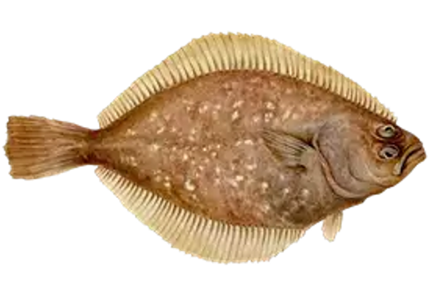
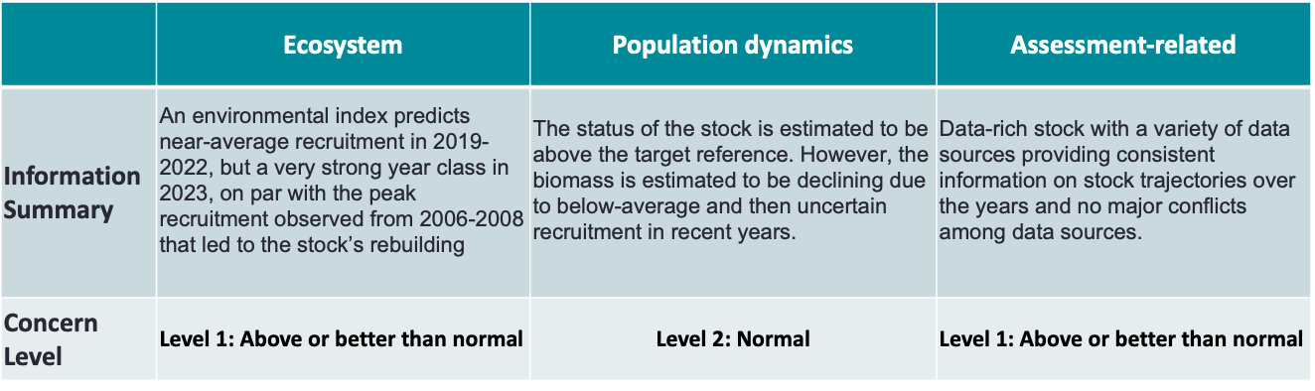
2023 CCE Petrale sole (draft) risk table
Notes:
An environmental index found that degree days during the pelagic juvenile phase and long-shore transport during the larval stage were the best predictors of recruitment variability (Appendix of Taylor et al., 2023). The index predicts near-average recruitment in 2019-2022, but a very strong year class in 2023, on par with the peak recruitment observed from 2006-2008 that led to the stock’s rebuilding. An index of juvenile petrale sole from the West Coast Groundfish Bottom Trawl Survey did not identify a strong 2022 year class, which is consistent with the environmental index.
Here, for example, is the risk table for Gulf of Alaska cod in 2020.
READ
Now, if these had indicated higher levels of concern or if there had been considerable disagreement across different sources of information, the Council might have chosen a precautionary recommendation for harvest levels, relative to the recommendation from the stock assessment.
This approach nicely integrates relevant ecosystem information into the management process, and seems likely to be adopted elsewhere; I believe it is now being considered by the IEA team and Councils in the Northeast US.

Slide 22
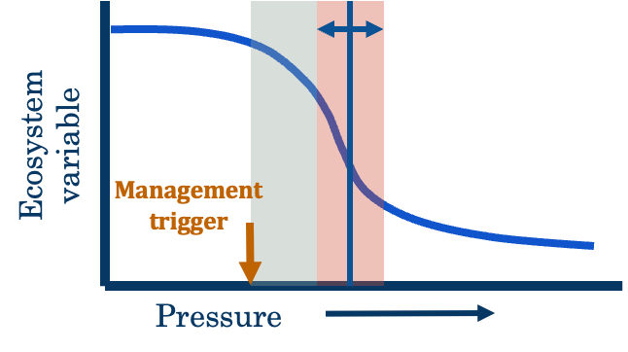
2023 CCE Petrale sole (draft) risk table
Oceanographic drivers
Changes in habitat
Food web dynamics
Range shifts
Direct and indirect non-fishing effects (OSW)
ESR indicators
Notes:
An environmental index found that degree days during the pelagic juvenile phase and long-shore transport during the larval stage were the best predictors of recruitment variability (Appendix of Taylor et al., 2023). The index predicts near-average recruitment in 2019-2022, but a very strong year class in 2023, on par with the peak recruitment observed from 2006-2008 that led to the stock’s rebuilding. An index of juvenile petrale sole from the West Coast Groundfish Bottom Trawl Survey did not identify a strong 2022 year class, which is consistent with the environmental index.
Here, for example, is the risk table for Gulf of Alaska cod in 2020.
READ
Now, if these had indicated higher levels of concern or if there had been considerable disagreement across different sources of information, the Council might have chosen a precautionary recommendation for harvest levels, relative to the recommendation from the stock assessment.
This approach nicely integrates relevant ecosystem information into the management process, and seems likely to be adopted elsewhere; I believe it is now being considered by the IEA team and Councils in the Northeast US.

Slide 23
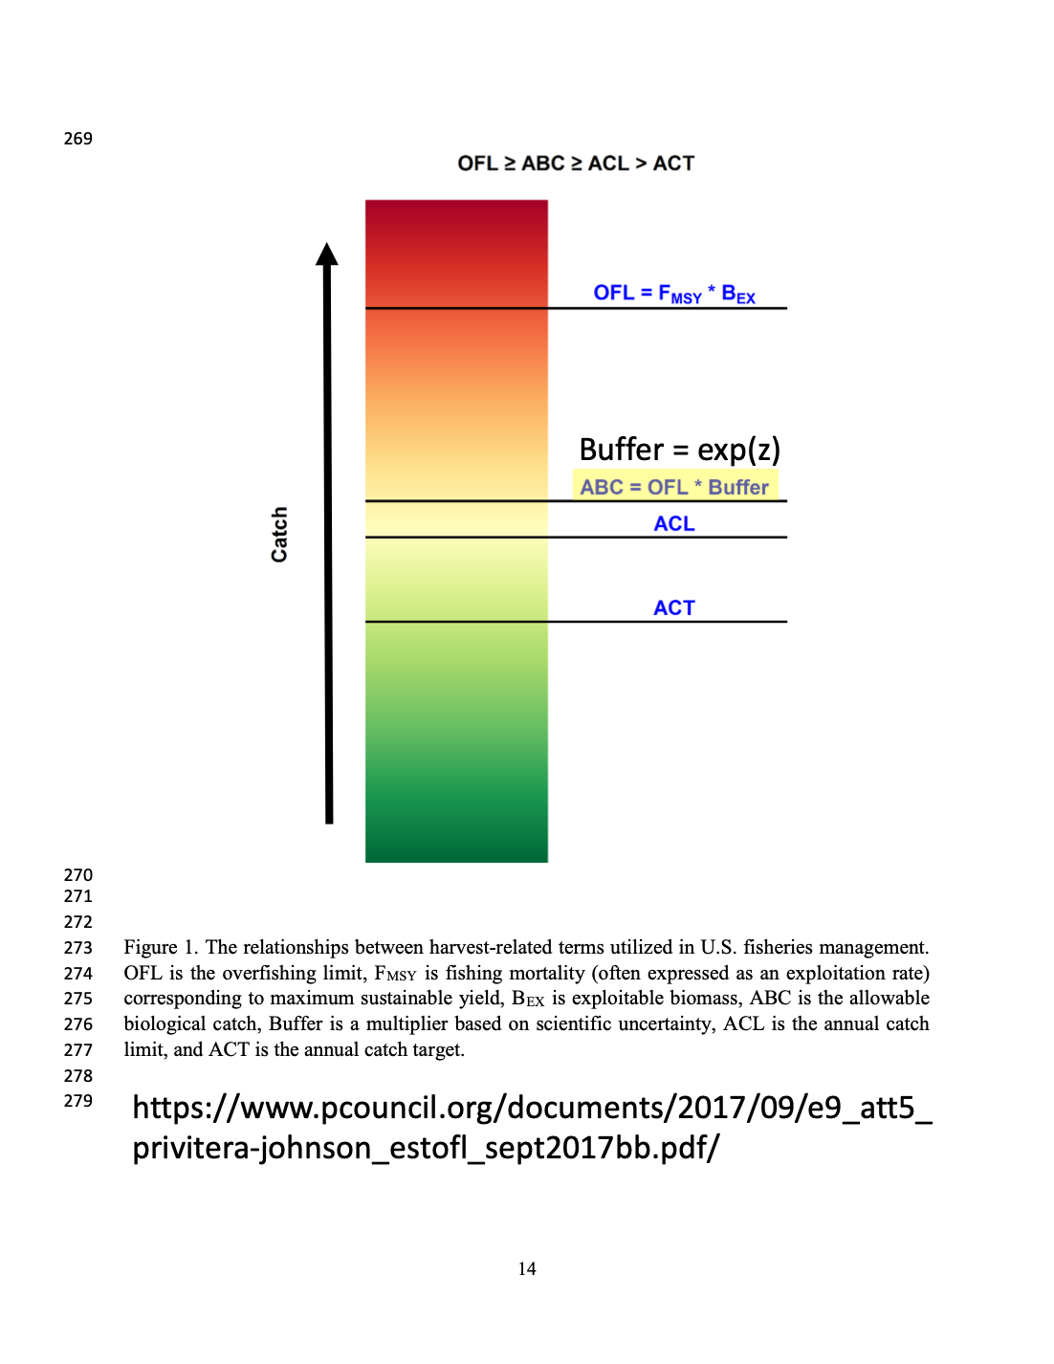
How might we use information from risk tables?
OFL – overfishing limit (assume some true unknown value, assessment is best estimate)
Sigma – scientific uncertainty in the OFL (SSC)
ABC – acceptable biological catch, reduced from OFL to account for uncertainty
ABC = OFL * Buffer (based on scientific uncertainty)
Notes:
There may be a few different pathways for incorporating information from the risk tables into the management process for different FMPs. I know we will have a discussion on this topic later today but I wanted to quickly touch on a few that have come up within the EWG and in discussions with members of ABs and stock assessment scientists. They include using this information to inform stock assessment prioritization, to set the scientific uncertainty buffer, to inform management uncertainty and risk tolerance. This information could influence how the penalty function gets applied for the age of the assessment. For e.g. the penalty could be reduced if there evidence of high recruitment events and vice versa. The risk tables may also be used to inform in-season adjustments.

